Slide 1
Interactive Ray Tracing of Large Models Using Voxel Hierarchies
Attila T. Áfra
Budapest University of Technology, Hungary
Babeș-Bolyai University, Romania

Slide 2
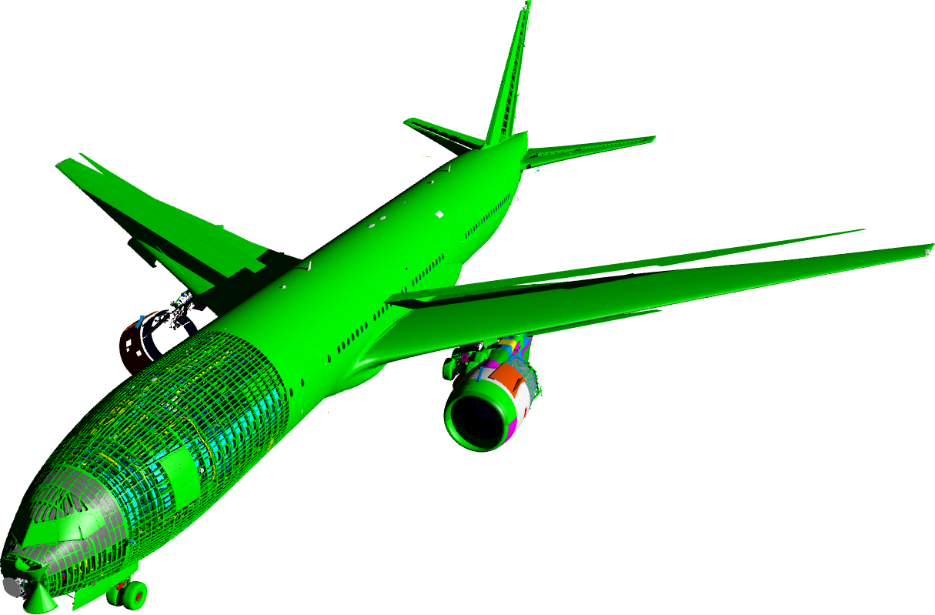
Massive model rendering
Billions of primitives
CAD
Scientific visualization
3D scanning
Visual effects
Many challenges
Limited memory usage
Interactive performance
Quality / advanced shading
Boeing 777
337M triangles
13 GB

Slide 3
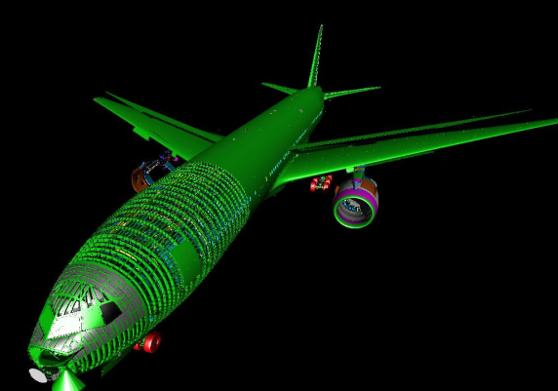
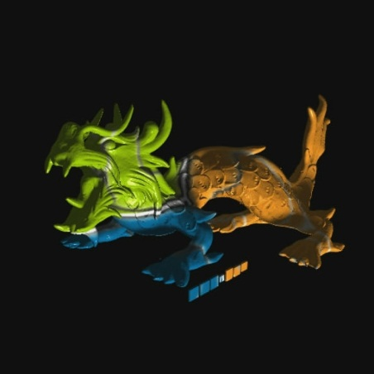
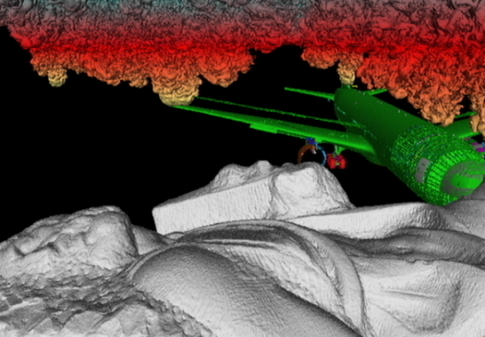
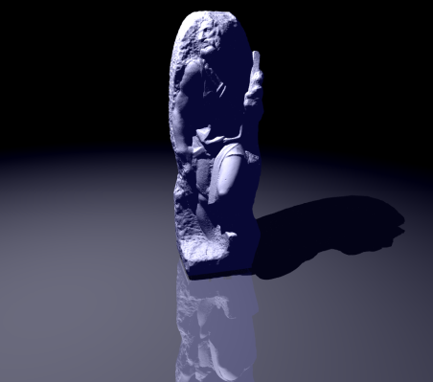
Previous work
… and many more!
[Wald et al. 2004]
GigaVoxels [Crassin et al. 2009]
Far Voxels
[Gobbetti and Marton 2005]
R-LODs [Yoon et al. 2006]

Slide 4
Feature comparison
Method | Polys | General LOD | Direction- dependent LOD | Shadow | GI | Async. I/O | Compress
Wald et al. 2004 | ✓ | ✗ | ✓ | ✓ | ✗ | ✓ | ✓
Far Voxels 2005 | ✓ | ✓ | ✓ | ✗ | ✗ | ✓ | ✓
R-LODs 2006 | ✓ | ✓ | ✗ | ✓ | ✗ | ✗ | ✗
GigaVoxels 2009 | ✗ | ✓ | ✓ | ✓ | ✓ | ✓ | ✓
Our (VoxLOD) | ✓ | ✓ | ✓ | ✓ | ✓ | ✓ | ✓

Slide 5
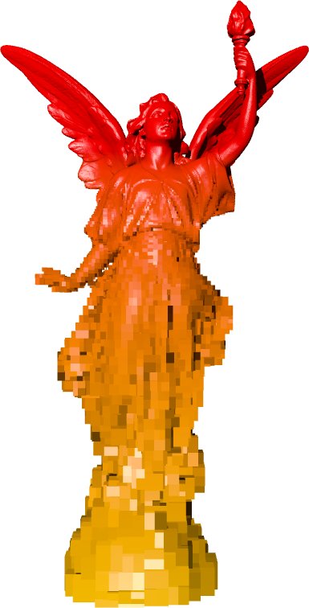
Method overview
Ray tracing (CPU)
Out-of-core kd-tree
Original geometry: triangles
LOD: voxels
Custom memory manager
Software address translation
Asynchronous I/O, compression

Slide 6
Out-of-core kd-tree
Three types of nodes
Basic
LOD: voxel
Every 3rd level
Leaf: triangles
Grouped into treelets
LOD → other treelets
Leaf → triangles

Slide 7
Blocks
Treelets → blocks
Breadth-first order
Two types of blocks
Treelet blocks
Triangle blocks
Blocks → LOD levels
Block size: 64 KB
LZ compressed
Ratio: ~50-60%

Slide 8
LOD voxel
Fills kd-node
kd-node

Slide 9
LOD voxel
Fills kd-node
Shading attributes
Normal
Color
Per-face or average
kd-node
normal

Slide 10
LOD voxel
Fills kd-node
Shading attributes
Normal
Color
Per-face or average
Radius of enclosing sphere → LOD
kd-node
normal
R

Slide 11
LOD voxel
Fills kd-node
Shading attributes
Normal
Color
Per-face or average
Radius of enclosing sphere → LOD
kd-node
normal
R

Slide 12
LOD error metric
Simple projected screen-space error metric
Error: area of sphere in pixels [Yoon et al. 2006]
Primary, shadow, planar reflection rays
Diffuse, AO rays
Error: solid angle ($2π/n$) [Pantaleoni et al. 2010]
$$d$$
$$d∙C>R$$
$$R$$

Slide 13
Ray traversal algorithm
if node is LOD
if children not loaded
request block, intersect voxel
break
if LOD error < threshold
intersect voxel
break
...
else if node is leaf
if triangles not loaded
request block, intersect last voxel
break
...

Slide 14
Ray traversal algorithm
if node is LOD
if children not loaded
request block, intersect voxel
break
if LOD error < threshold
intersect voxel
break
...
else if node is leaf
if triangles not loaded
request block, intersect last voxel
break
...

Slide 15
Ray traversal algorithm
if node is LOD
if children not loaded
request block, intersect voxel
break
if LOD error < threshold
intersect voxel
break
...
else if node is leaf
if triangles not loaded
request block, intersect last voxel
break
...

Slide 16
Ray traversal algorithm
Primary & shadow rays are traced in packets
4x4 pixels
SIMD: SSE, AVX, IMCI, etc.
LOD benefits:
Fewer traversal steps
Higher coherence
Smaller working set

Slide 17
Memory manager
LRU cache → blocks
Renderer threads → block request lists
Fetcher threads
Load blocks requested in the previous frame
Cache update after each frame
Enable new blocks
Gather and prioritize block requests
Evict old blocks

Slide 18
Rendering loop
Frame 1
Render 1
Render 1
Render 1
Render 1
Fetch 0
Fetch 0
Frame 1
Update 1
Frame 2
Render 2
Render 2
Render 2
Render 2
Fetch 1
Fetch 1
Frame 2
Update 2
…

Slide 19
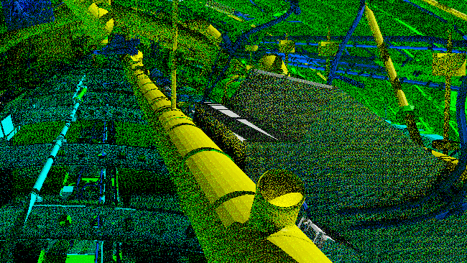
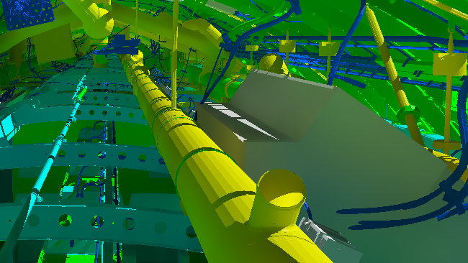
Shading
Hard and soft shadows
Ambient occlusion
Diffuse indirect illumination
1 bounce, 2 samples per pixel
Very noisy → bilateral filter (GPU)

Slide 20
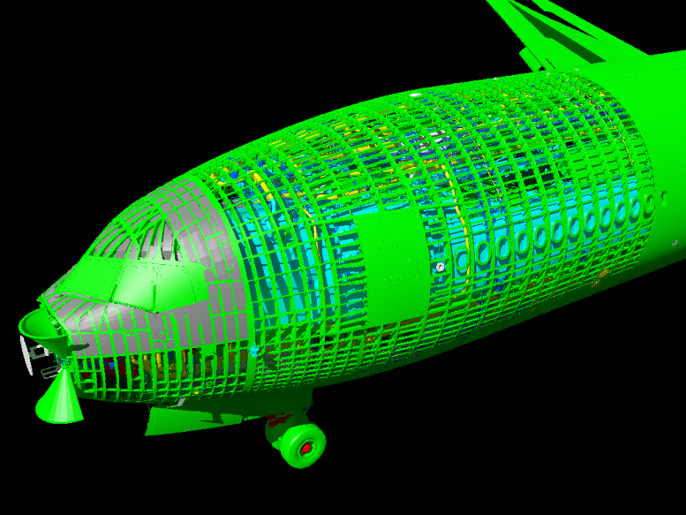
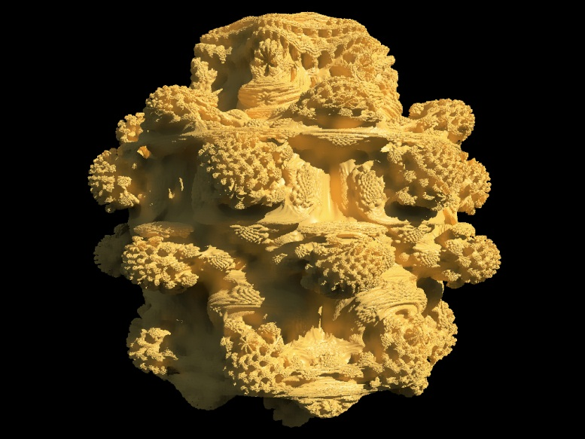
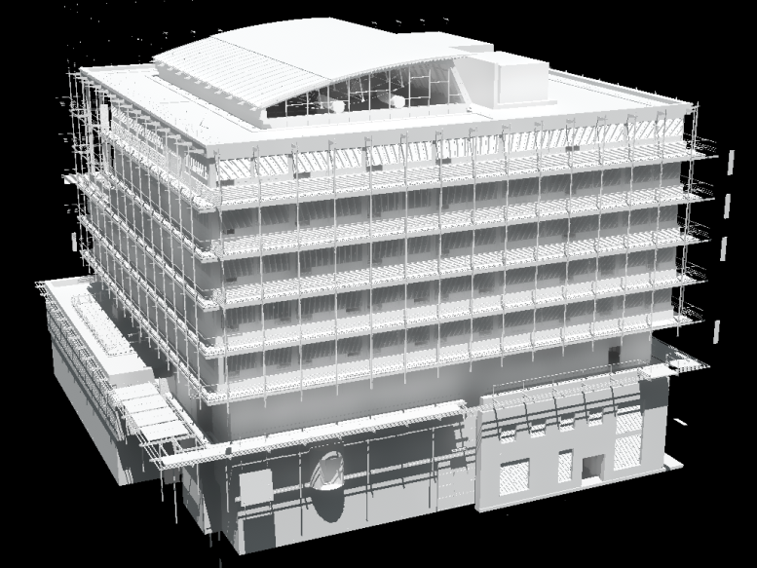
Results

Slide 21
Results
Frames per second
Core i7-2600, 8 GB RAM, 1024x768, 3 pixels of error

Slide 22
Video: Boeing 777 (31 GB)
Core i7-3770, 8 GB RAM, SSD, 1280x720, 1.5 pixels of error

Slide 23
Scalability
Render time (ms)
Mandelbulb

Slide 24
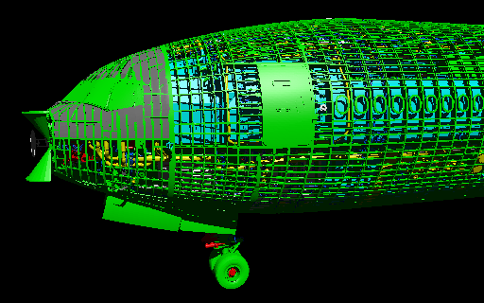
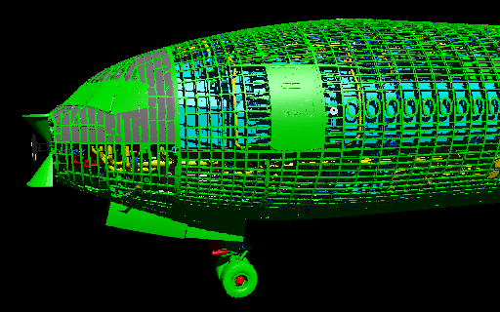
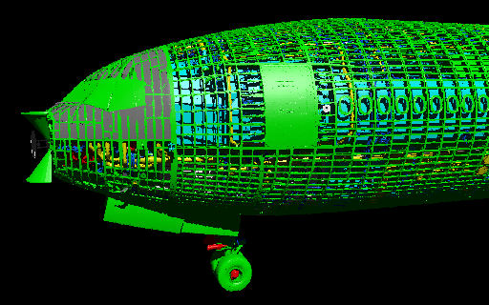
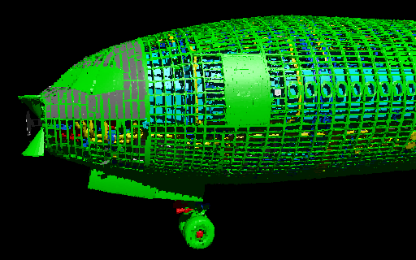
LOD quality: pixels of error (PoE)
0 PoE (reference)
1 PoE
3 PoE
16 PoE

Slide 25
LOD quality: 0 PoE (reference)

Slide 26
LOD quality: 1 PoE

Slide 27
LOD quality: 3 PoE

Slide 28
LOD quality: 16 PoE

Slide 29
LOD quality: 0.25 PoE, 4x anti-aliasing

Slide 30
Loading speed
Core i7-3770, 8 GB RAM, SSD, 1280x720, 1 pixel of error

Slide 31
Conclusions
Advantages
Support for complex, CAD-like scenes
Smooth exploration, zero startup time
Shadows, global illumination
Compressed data structure
Limitations
LOD artifacts
Reflection, refraction not supported

Slide 32
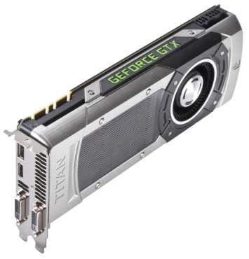
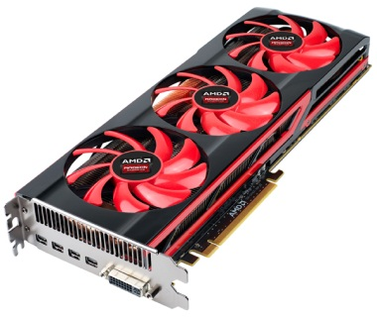
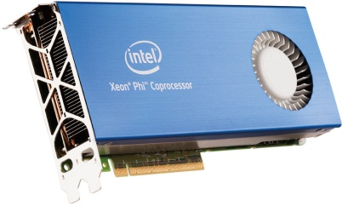
Future work
Adapt to accelerator cards
GPU
MIC (Xeon Phi)
Much better performance
Limited memory: up to 8 GB!
Optimize for incoherent rays → BVH?
Higher quality LOD → transparent voxels?

Slide 33
Thank you!

